Slide 1
Lesson 10
How to design a database
Lecture adapted from Murach’s MySQL Textbooks

Slide 2
Objectives
Applied
Given the specifications for a database, identify the tables, columns, keys, relationships, and indexes for the database.
Given the tables for an unnormalized database, normalize the structure to the third normal form.
Use MySQL Workbench to create or work with an EER model for a database and any EER diagrams that are associated with that model.

Slide 3
Objectives (continued)
Knowledge
Give three criteria for when a column should be indexed.
Describe referential integrity.
Explain how MySQL uses declarative referential integrity to prevent deletion, insertion, and update problems.
Explain how normalizing a database to the third normal form affects database performance.

Slide 4
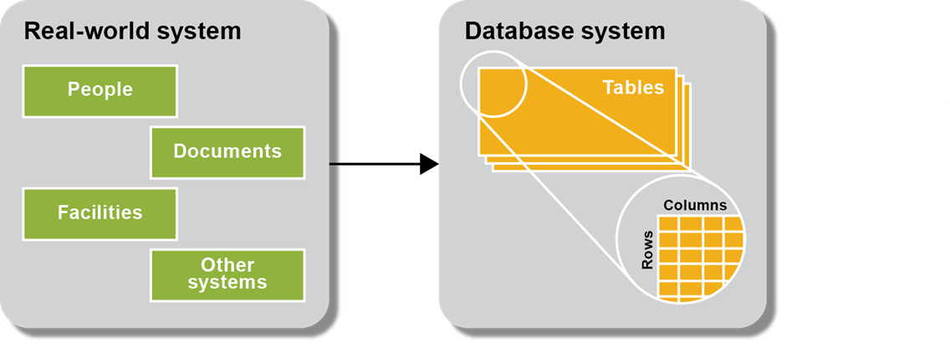
A database system is modeled after a real-world system

Slide 5
The six basic steps for designing a data structure
Step 1: Identify the data elements
Step 2: Subdivide each element into its smallest useful components
Step 3: Identify the tables and assign columns
Step 4: Identify the primary and foreign keys
Step 5: Review whether the data structure is normalized
Step 6: Identify the indexes

Slide 6
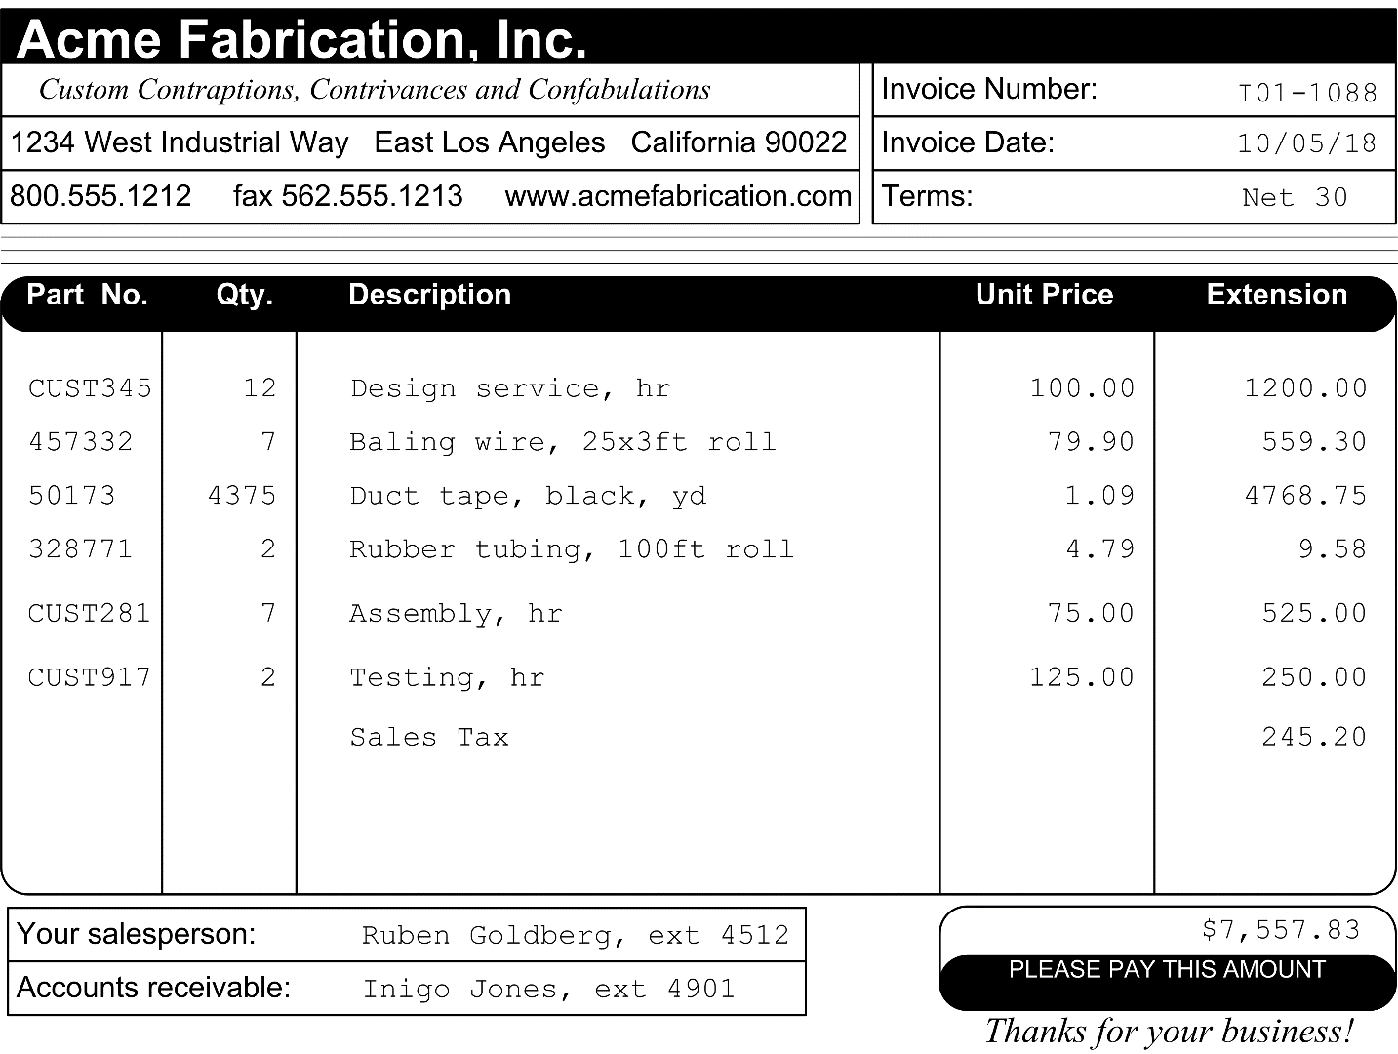
An invoice that’s used to identify data elements

Slide 7
The data elements on the invoice document
Vendor name Item quantity
Vendor address Item description
Vendor phone number Item unit price
Vendor fax number Item extension
Vendor web address Vendor sales contact name
Invoice number Vendor sales contact extension
Invoice date Vendor AR contact name
Invoice terms Vendor AR contact extension
Item part number Invoice total

Slide 8
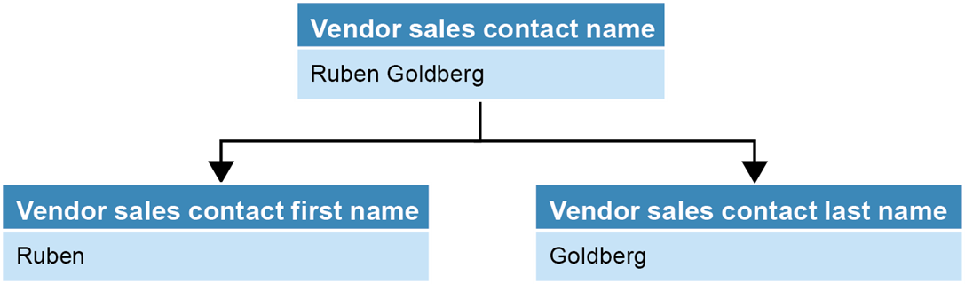
A name that’s divided into first and last names

Slide 9
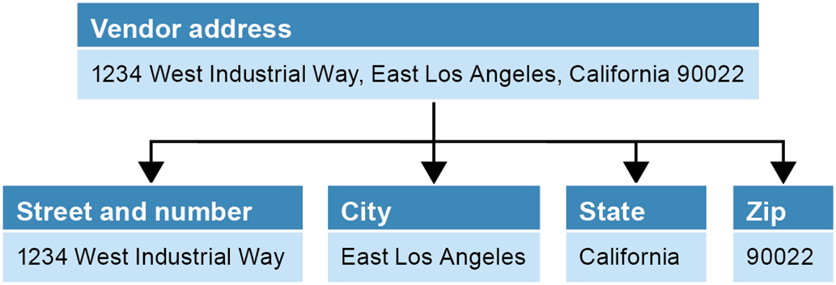
An address that’s divided into its components

Slide 10
Possible tables and columns for an A/P system
Vendors Invoices
Vendor name Invoice number*
Vendor address Invoice date
Vendor city Terms*
Vendor state Invoice total
Vendor zip code Payment date
Vendor phone number Payment total
Vendor fax number Invoice due date
Vendor web address Credit total
Vendor contact first nameAccount number*
Vendor contact last name
Vendor contact phone
Vendor AR first name

Slide 11
Possible tables and columns for an A/P system (continued)
Vendors Invoice line items
Vendor AR last name Invoice number*
Vendor AR phone Item part number
Terms* Item quantity
Account number* Item description
Item unit price
Item extension
Account number*
Sequence number

Slide 12
The notation for identifying data elements
Data elements that were previously identified but aren’t needed are crossed out.
Data elements that were added are displayed in italics.
Data elements that are related to two or more entities are followed by an asterisk.

Slide 13
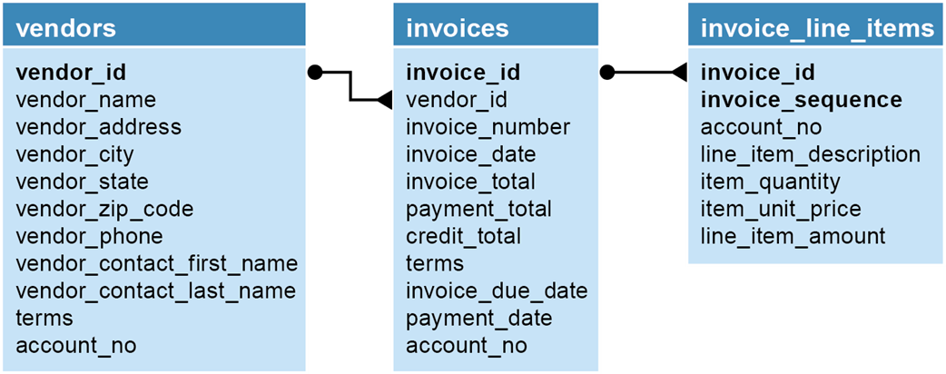
The relationships between the tables

Slide 14
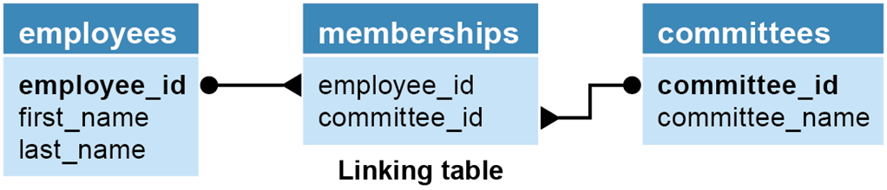
Two tables with a many-to-many relationship

Slide 15
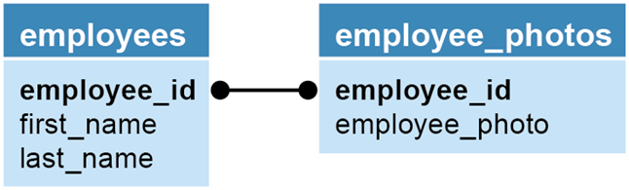
Two tables with a one-to-one relationship

Slide 16
Operations that can violate referential integrity
Deleting a row from the primary key table
If the foreign key table contains one or more rows related to the deleted row
Inserting a row in the foreign key table
If the foreign key value doesn’t have a matching primary key value in the related table
Updating the value of a foreign key
If the new foreign key value doesn’t have a matching primary key value in the related table
Updating the value of a primary key
If the foreign key table contains one or more rows related to the row that’s changed

Slide 17
When to create an index
When the column is used frequently in search conditions or joins
When the column contains a large number of distinct values
When the column is updated infrequently

Slide 18
Terms to know about data structures
Entity
Attribute
Instance
Entity-relationship (ER) modeling
Referential integrity
Declarative referential integrity (DRI)
Foreign key constraint
Orphaned row

Slide 20
Entity Relationship Diagrams

Slide 21
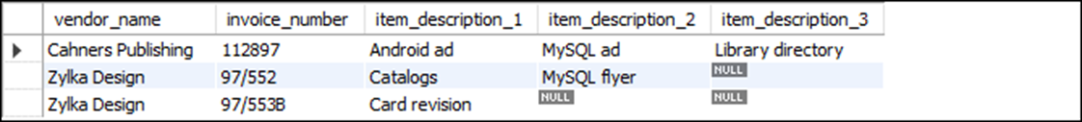
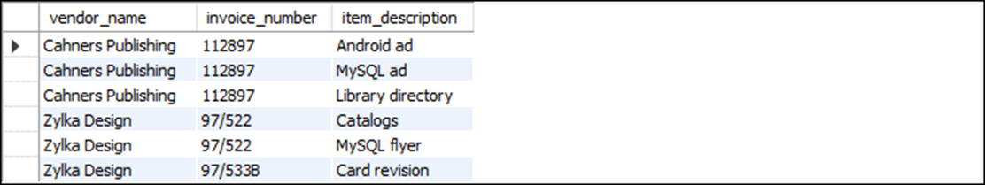
Two tables that need to be normalized
A table that contains repeating columns
A table that contains redundant data

Slide 22
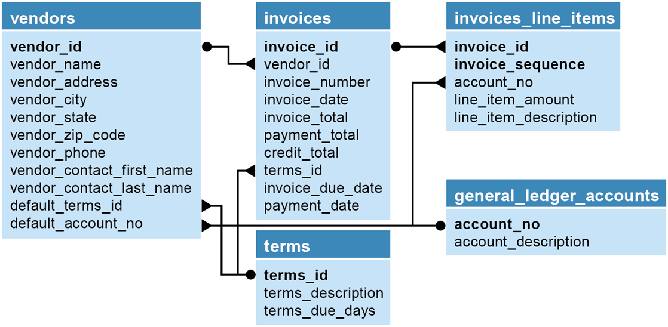
The accounts payable system in third normal form

Slide 23
Terms to know about normalizing a data structure
Normalization
Data redundancy
Unnormalized data structure
Normalized data structure
Normal form

Slide 24
The first three normal forms
Normal form Description
First (1NF) The value stored at the intersection of each row and column must be a scalar value, and a table must not contain any repeating columns.
Second (2NF) Every non-key column must depend on the entire primary key.
Third (3NF) Every non-key column must depend only on the primary key.
*Note
Most designers stop at the third normal form.

Slide 25
The next four normal forms
Normal form Description
Boyce-Codd (BCNF) A non-key column can’t be dependent on another non-key column.
Fourth (4NF) A table must not have more than one multivalued dependency, where the primary key has a one-to-many relationship to non-key columns.
Fifth (5NF) The data structure is split into smaller and smaller tables until all redundancy has been eliminated.
Domain-key (DKNF)
Every constraint on the relationship is or dependent only on key constraints and Sixth (6NF) domain constraints, where a domain is the set of allowable values for a column.

Slide 26
The benefits of normalization
More tables, and each table has an index on its primary key. That makes data retrieval more efficient.
Each table contains information about a single entity. That makes data retrieval and insert, update, and delete operations more efficient.
Each table has fewer indexes, which makes insert, update, and delete operations more efficient.
Data redundancy is minimized, which simplifies maintenance and reduces storage.

Slide 27
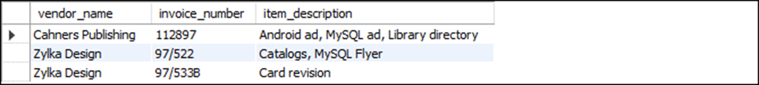
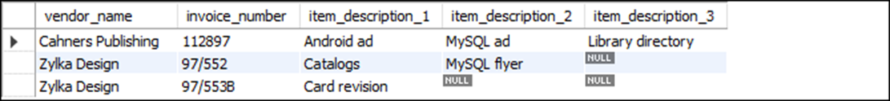
Unnormalized invoice data
The invoice data with a column that contains repeating values
The invoice data with repeating columns

Slide 28

The invoice data in first normal form

Slide 29
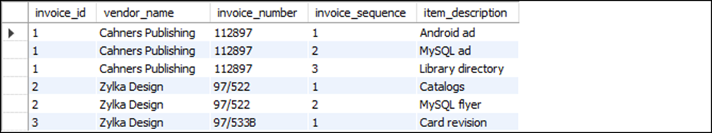
The invoice data in first normal form with keys added

Slide 30
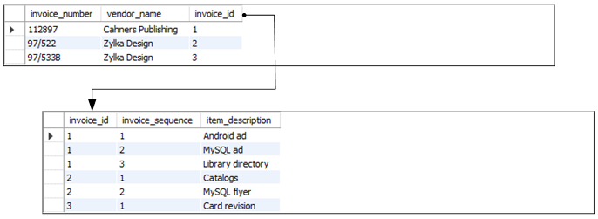
The invoice data in second normal form

Slide 31
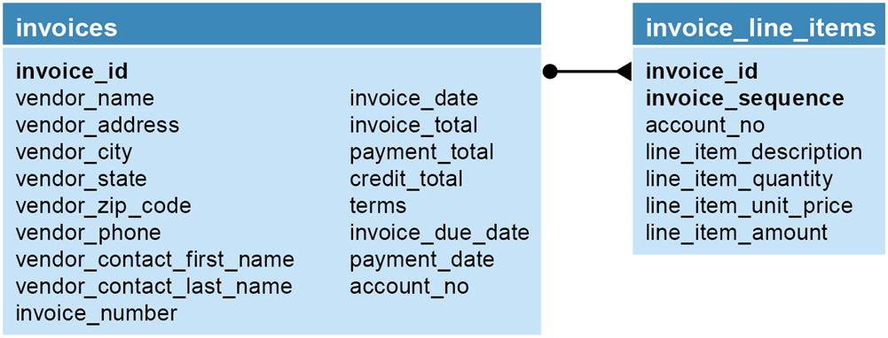
The A/P system in second normal form

Slide 32
Questions about the structure
Does the vendor information (vendor_name, vendor_address, etc.) depend only on the invoice_id column?
Does the terms column depend only on the invoice_id column?
Does the account_no column depend only on the invoice_id column?
Can the invoice_due_date and line_item_amount columns be derived from other data?

Slide 33
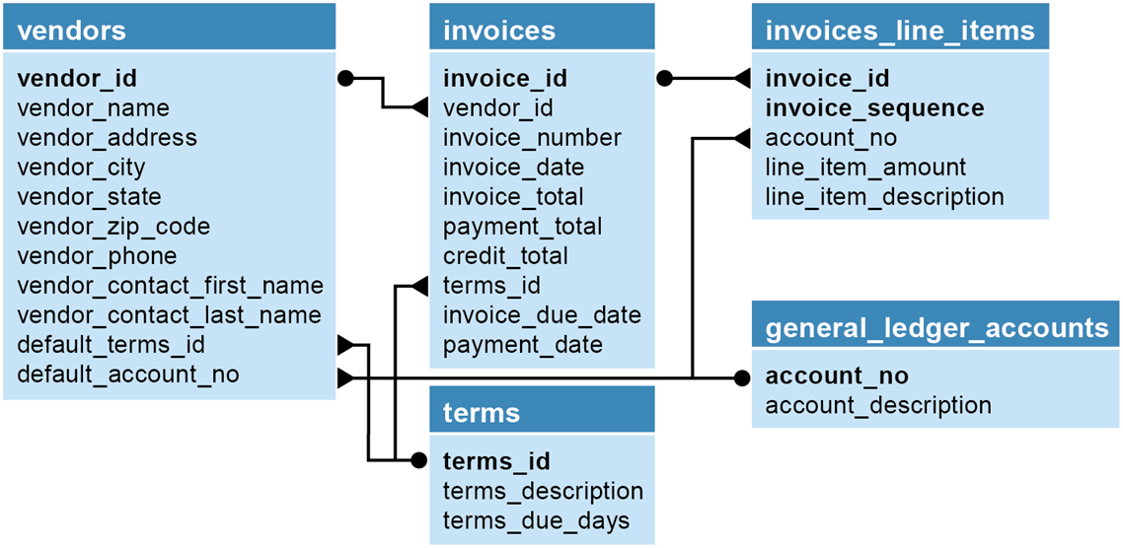
The A/P system in third normal form

Slide 34
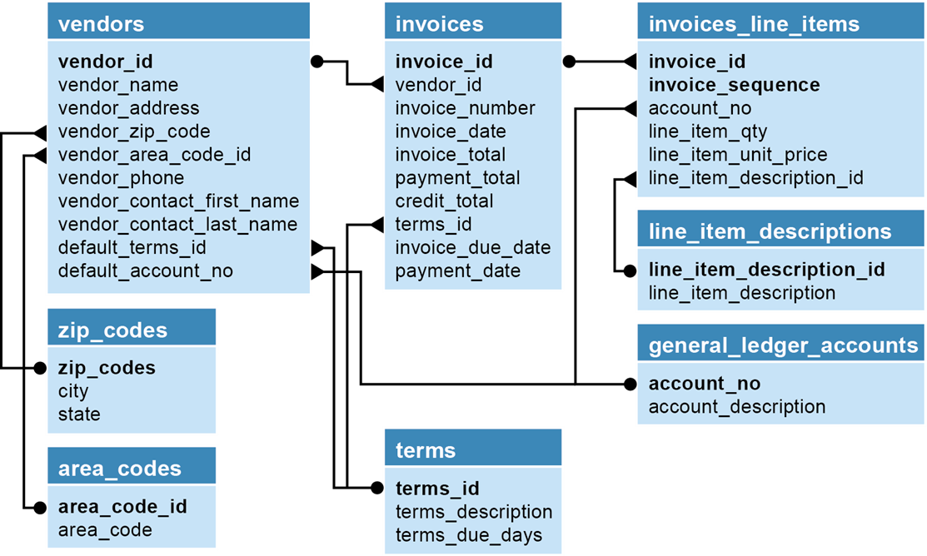
The A/P system in fifth normal form

Slide 35
When to denormalize
When a column from a joined table is used repeatedly in search criteria.
If a table is updated infrequently.
Include columns with derived values when those values are used frequently in search conditions.

Slide 37
Entity Relationship Diagrams

Slide 38
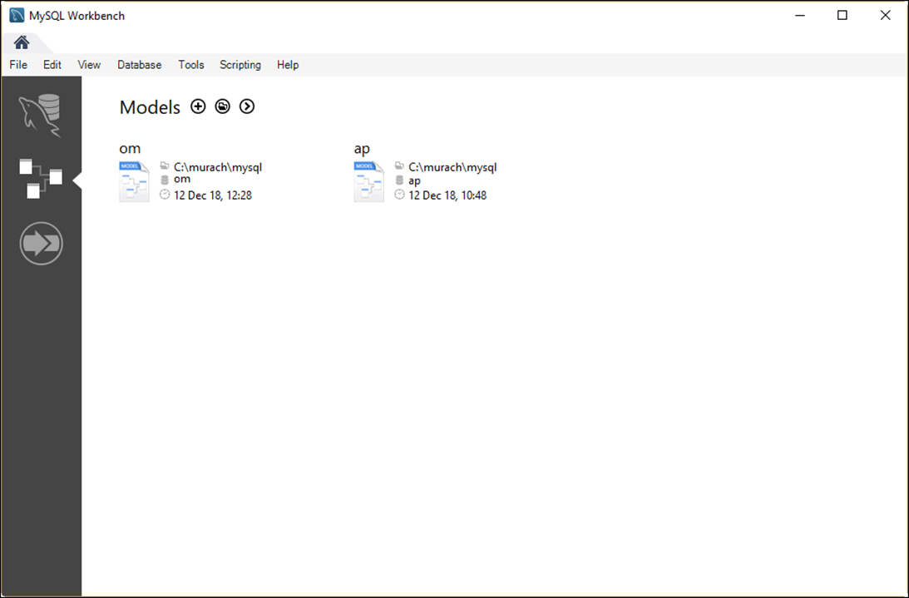
The Models tab of MySQL Workbench Home page

Slide 39
Operations you can perform from the Models tab
Open an existing EER model
Create a blank EER model
Create an EER model from an existing database
Create an EER model from a SQL creation script
Remove an EER model from the list

Slide 40
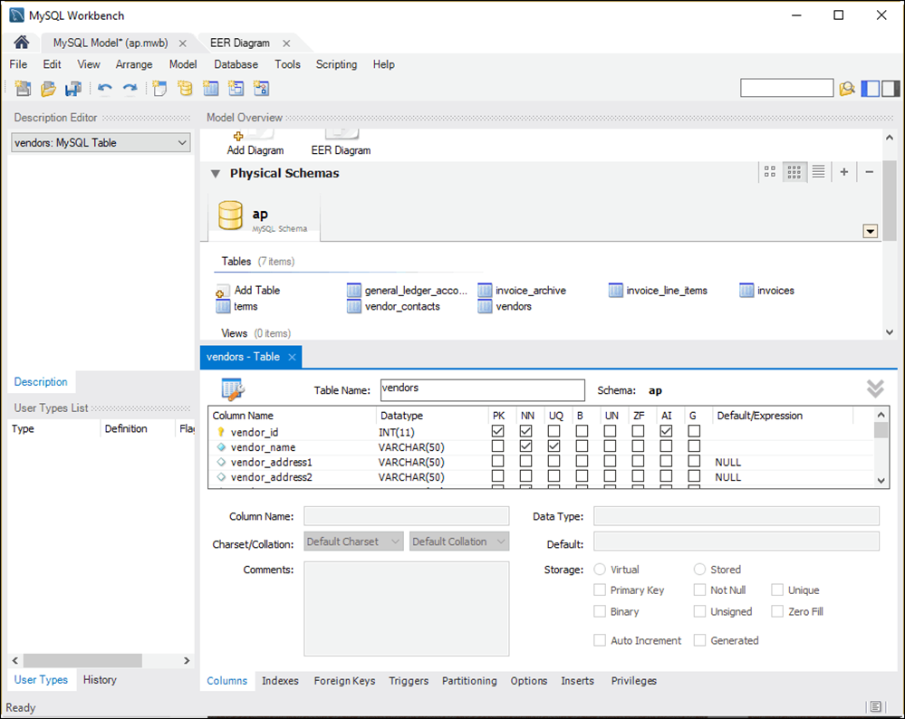
The EER model for the AP database

Slide 41
Operations for working with an EER model
Edit a table
Add a new table
Delete a table
Display a diagram
Create a new diagram
Create a database creation script from the model

Slide 42
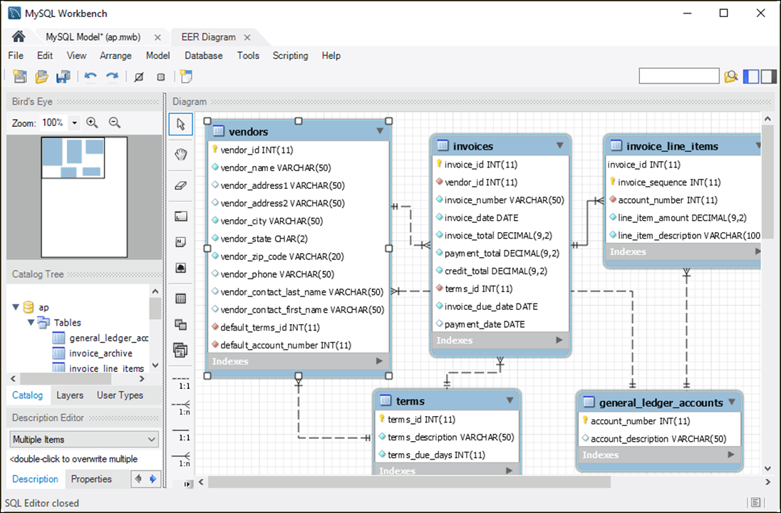
The EER diagram for the AP database

Slide 43
Operations for working with an EER Diagram
Add an existing table to the diagram
Add a new table to the diagram
Display the model for a table
Define the relationship between two tables
Edit and delete relationships
Remove a table from the diagram (and, optionally, the model)

